Slide 1
DevCon 2016 ASP.NET Core 1.0 Internals
Jon Galloway
Technical Evangelist
@jongalloway
jon.galloway@microsoft.com

Slide 2
Agenda: ASP.NET Core 1.0 Internals
Working with Static Files
Intro to Routing and MVC
Writing Custom Middleware
Add Authentication to your Web Applications
Disclaimer: This is an advanced session

Slide 3
ASP.NET Core: a very quick overview

Slide 4


ASP.NET and the Modern Web
Totally Modular
Faster Development Cycle
Seamless transition from on-premises to cloud
Choose your Editors
and Tools
Open Source with Contributions
OSS
Cross-Platform
Fast

Slide 5



ASP.NET 4.6 and ASP.NET Core 1.0
ASP.NET 4.6
ASP.NET Core 1.0
.NET Framework 4.6
.NET Core 1.0
.NET framework libraries
.NET core libraries
Compilers and runtime components (.NET Compiler Platform: Roslyn, C#, VB, F# Languages, RyuJIT, SIMD)

Slide 6
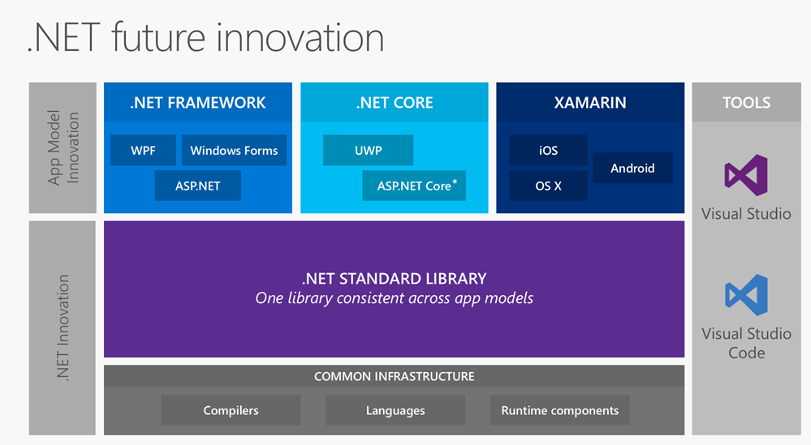

Slide 7
What about ASP.NET 5?
ASP.NET Core 1.0 was previously called ASP.NET 5
It was renamed in January 2016
Announcement post
More details
You’ll still see it referred to as ASP.NET in Visual Studio and in some docs
Will be updated in next ASP.NET Core Release Candidate

Slide 8
ASP.NET Core 1.0 Roadmap
Milestone | Release week
Beta6 | 27 Jul 2015
Beta7 | 2 Sep 2015
Beta8 | 15 Oct 2015
RC1 | 18 Nov 2015
RC2 (Tools Preview 1) | 16 May 2016
1.0.0 (Tools Preview 2) | Late June 2016
https://github.com/aspnet/Home/wiki/Roadmap

Slide 9
Tools Installation

Slide 10
Feature Overview + Demos

Slide 11
Middleware

Slide 12
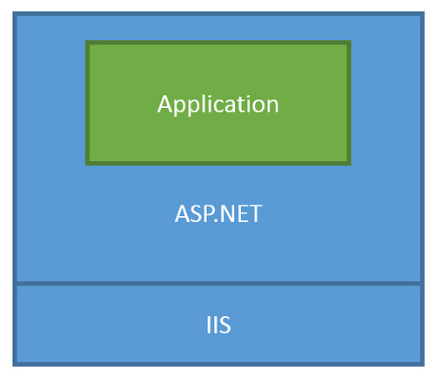
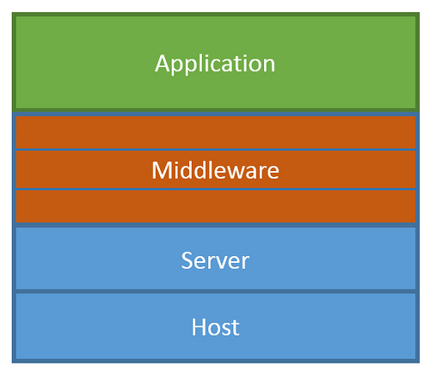
ASP.NET Core Middleware
Traditional ASP.NET Application Model
ASP.NET Core Middleware

Slide 13
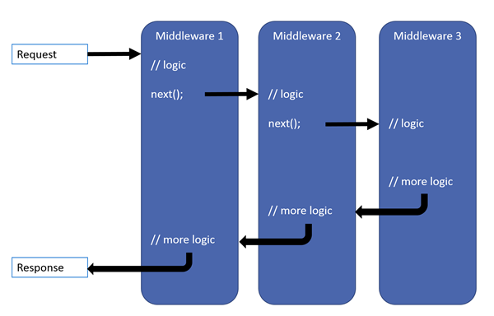
ASP.NET Core Middleware

Slide 14
Demo: Static File Middleware
Notes:
Time: TBD

Slide 15
MVC + API

Slide 16
Demo: Adding MVC features to Empty project
Notes:
Time: TBD

Slide 17
Demo: Adding an API
Notes:
Time: TBD

Slide 18
EF

Slide 19
Demo: In-memory Storage
Notes:
Time: TBD

Slide 20
Demo: Adding a Backing Database
Notes:
Time: TBD

Slide 21
Front End

Slide 22
Demo: Quick Look at Tag Helpers
Notes:
Time: TBD

Slide 23
Demo: Quick Front-end with TypeScript
Notes:
Time: TBD

Slide 24
Diagnostics

Slide 25
Demo: Diagnostics Middleware
Notes:
Time: TBD

Slide 26
LAB

Slide 27
https://github.com/jongalloway/DevCon2016 Get started, finish later Ask questions!
Notes:
Time: TBD

Slide 28
Wrap-up
[links here]
Notes:
Do this in the last 5 minutes of the event

